Slide 1

Web Scrapping on Ssense.com
Use Python to Crawl Competitors Data
Tianyao Liu

Slide 2
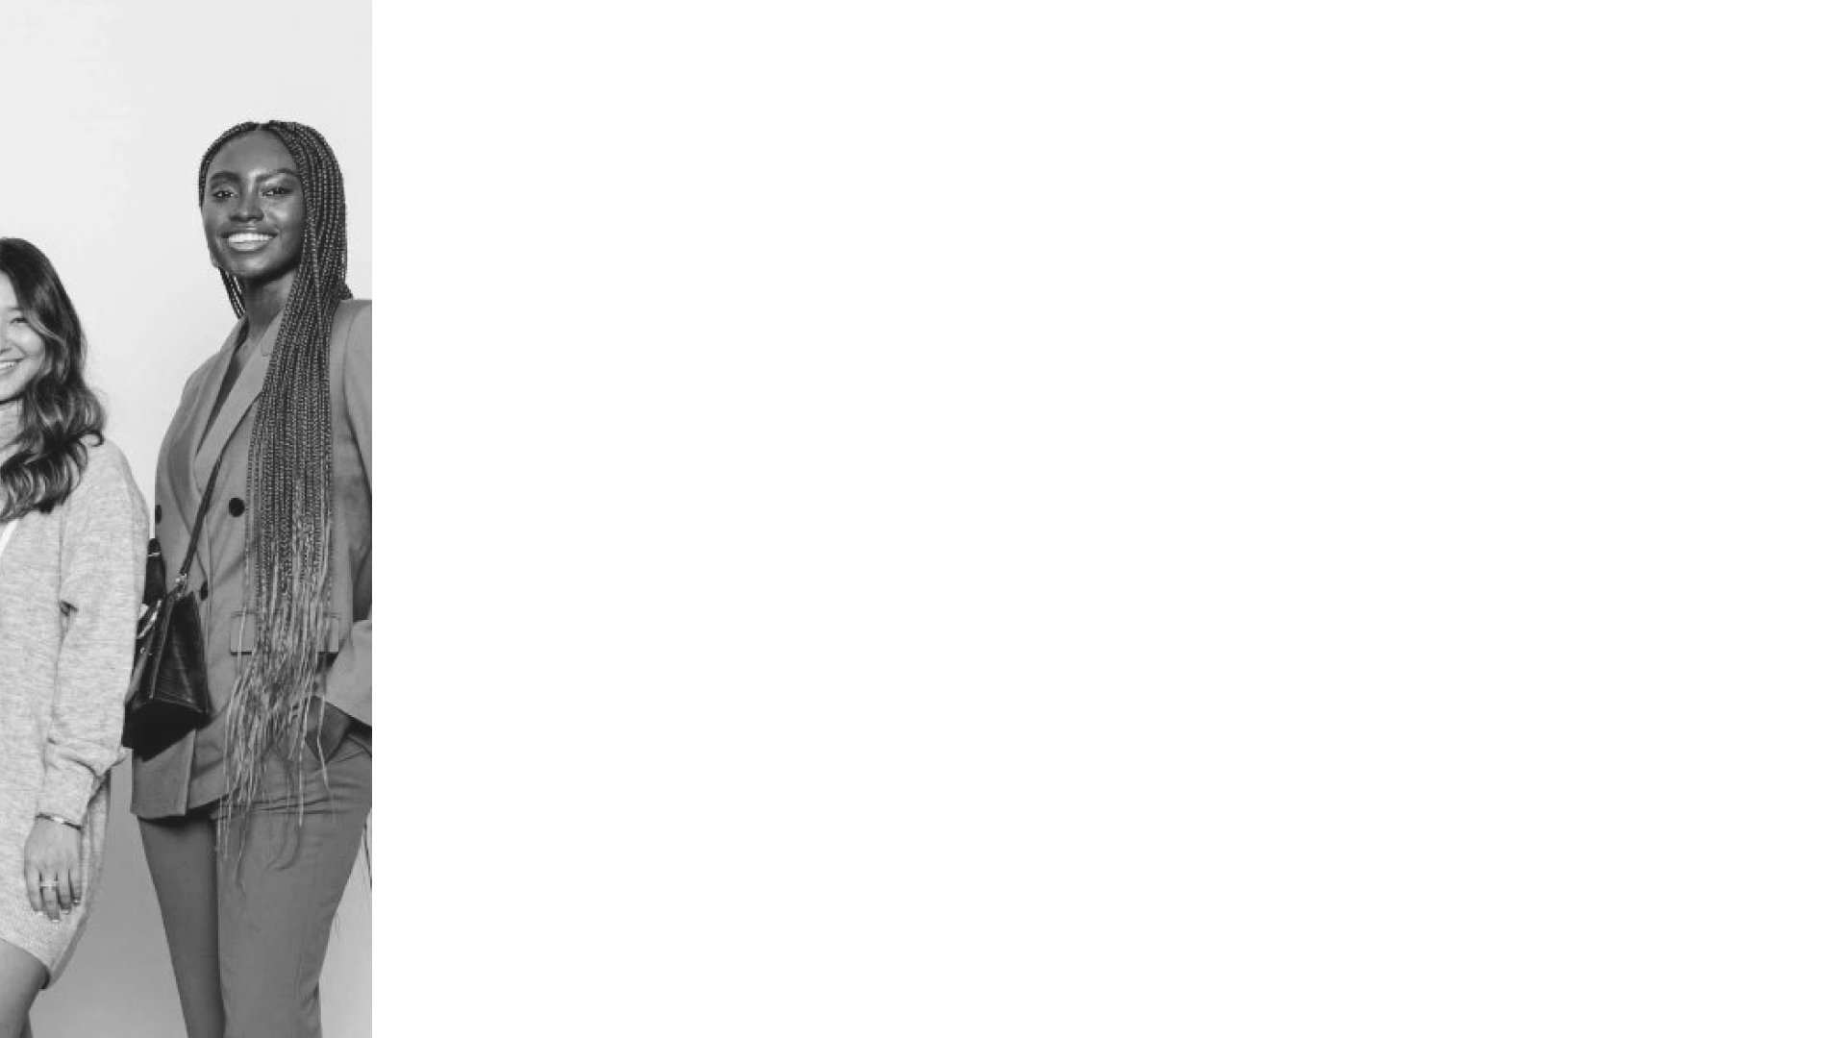
Agenda
Business Case Overview
Data Collection Methodology
Exploratory Analysis
Recommendations: Measure Long-term Success

Slide 3
Business Case Overview
Identification of the stakeholder and audience
Parisa Wang’s pricing analyst will be the stakeholder, since the factors such as price, brand image from other competitors will affect the Paris Wang's pricing strategy.
VP Marketing Department would be the audience to use this report for further decision-making.

Slide 4
Business Case Overview
Project objective and domain
The ask is for competitor’s pattern.
We could furtherly give the company more information by competitors and help them make decision.

Slide 5
Data Collection Methodology
What websites you are collecting data from?
I collected data from “www.ssense.com”.
It’s an also e-commerce and brick-and-mortar luxury and streetwear retailer based in Canada.

Slide 6
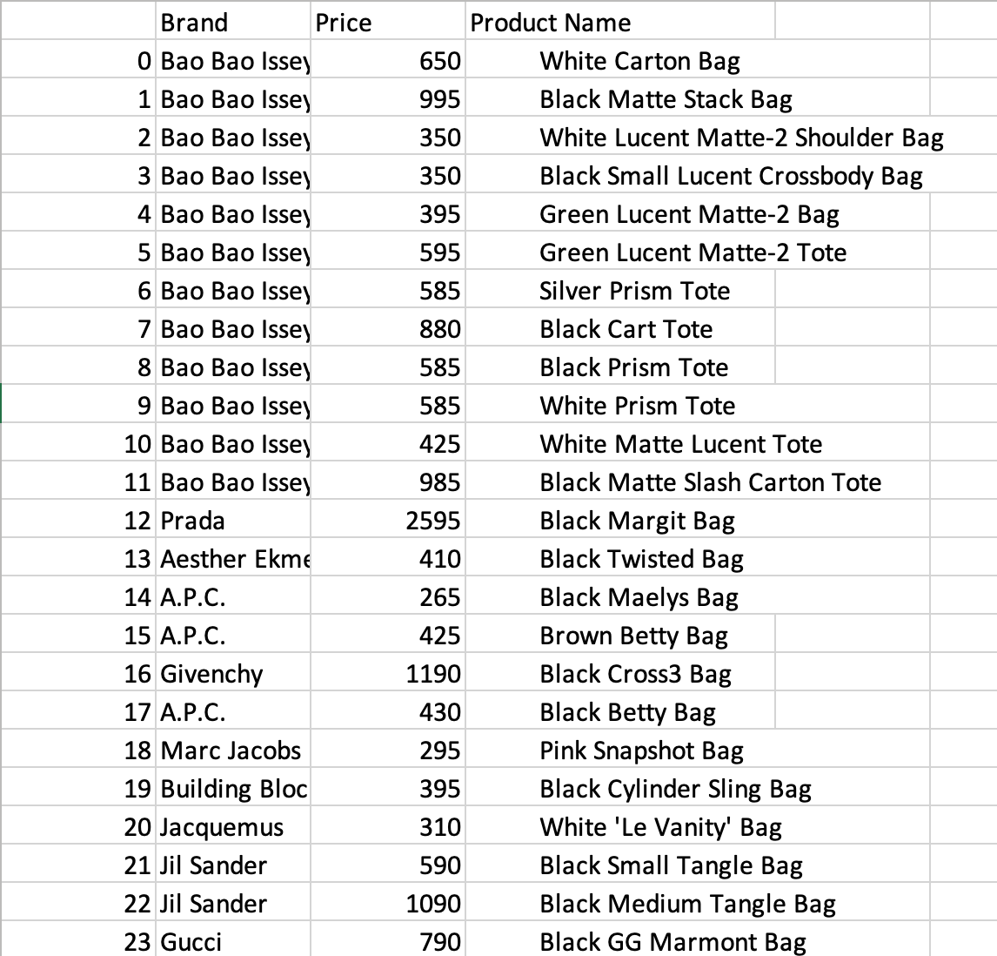
Data Collection Methodology
I collected brand name, price & product name, and these three main factors stand for the character.
Especially, the price collected is by the relevance featured by the official website.

Slide 7
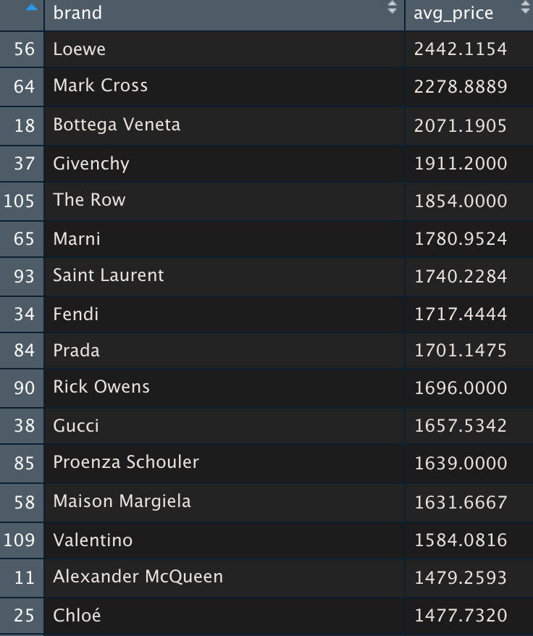
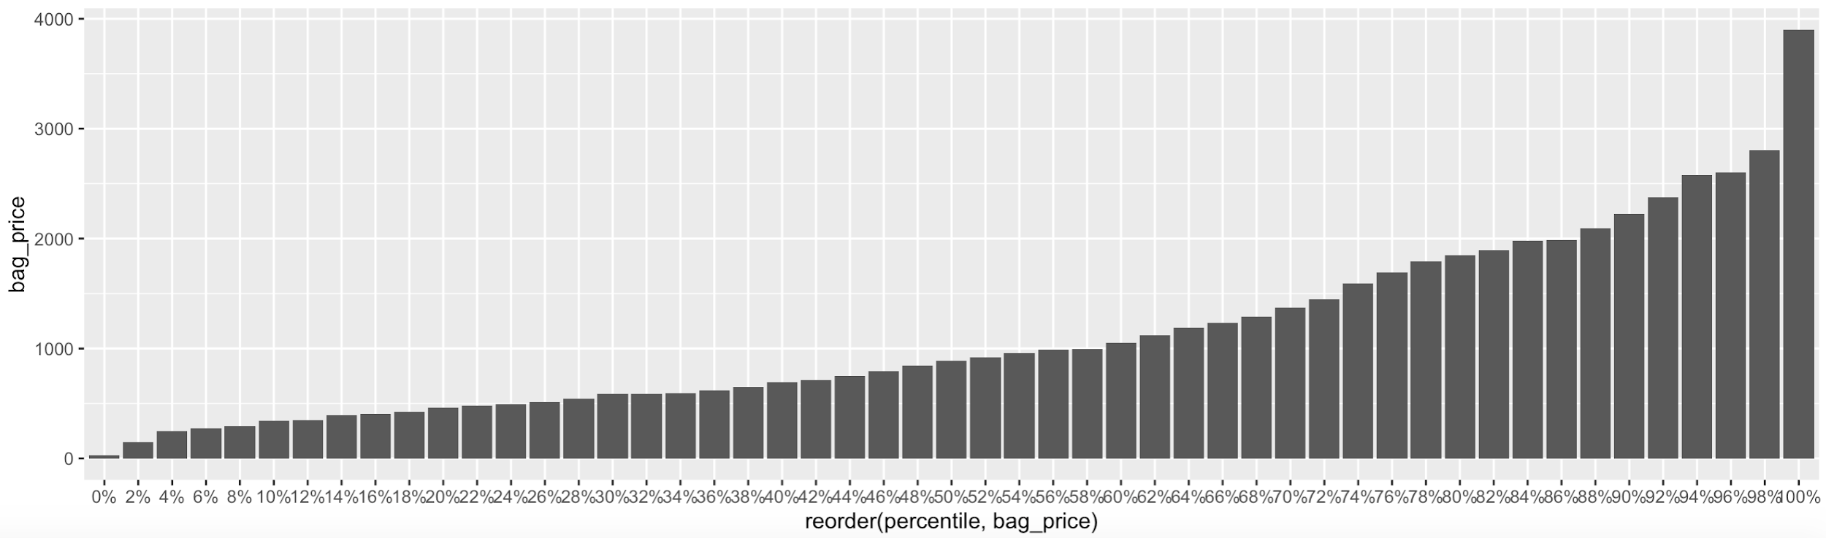
Exploratory Analysis
analysis and data visualization.
I got summary of price distribution of women bags in all pages. (1~41)
And the graphs of percentile by the range of prices; the price rank of different brands

Slide 8
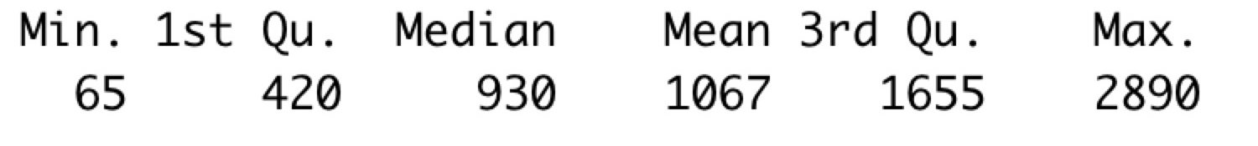
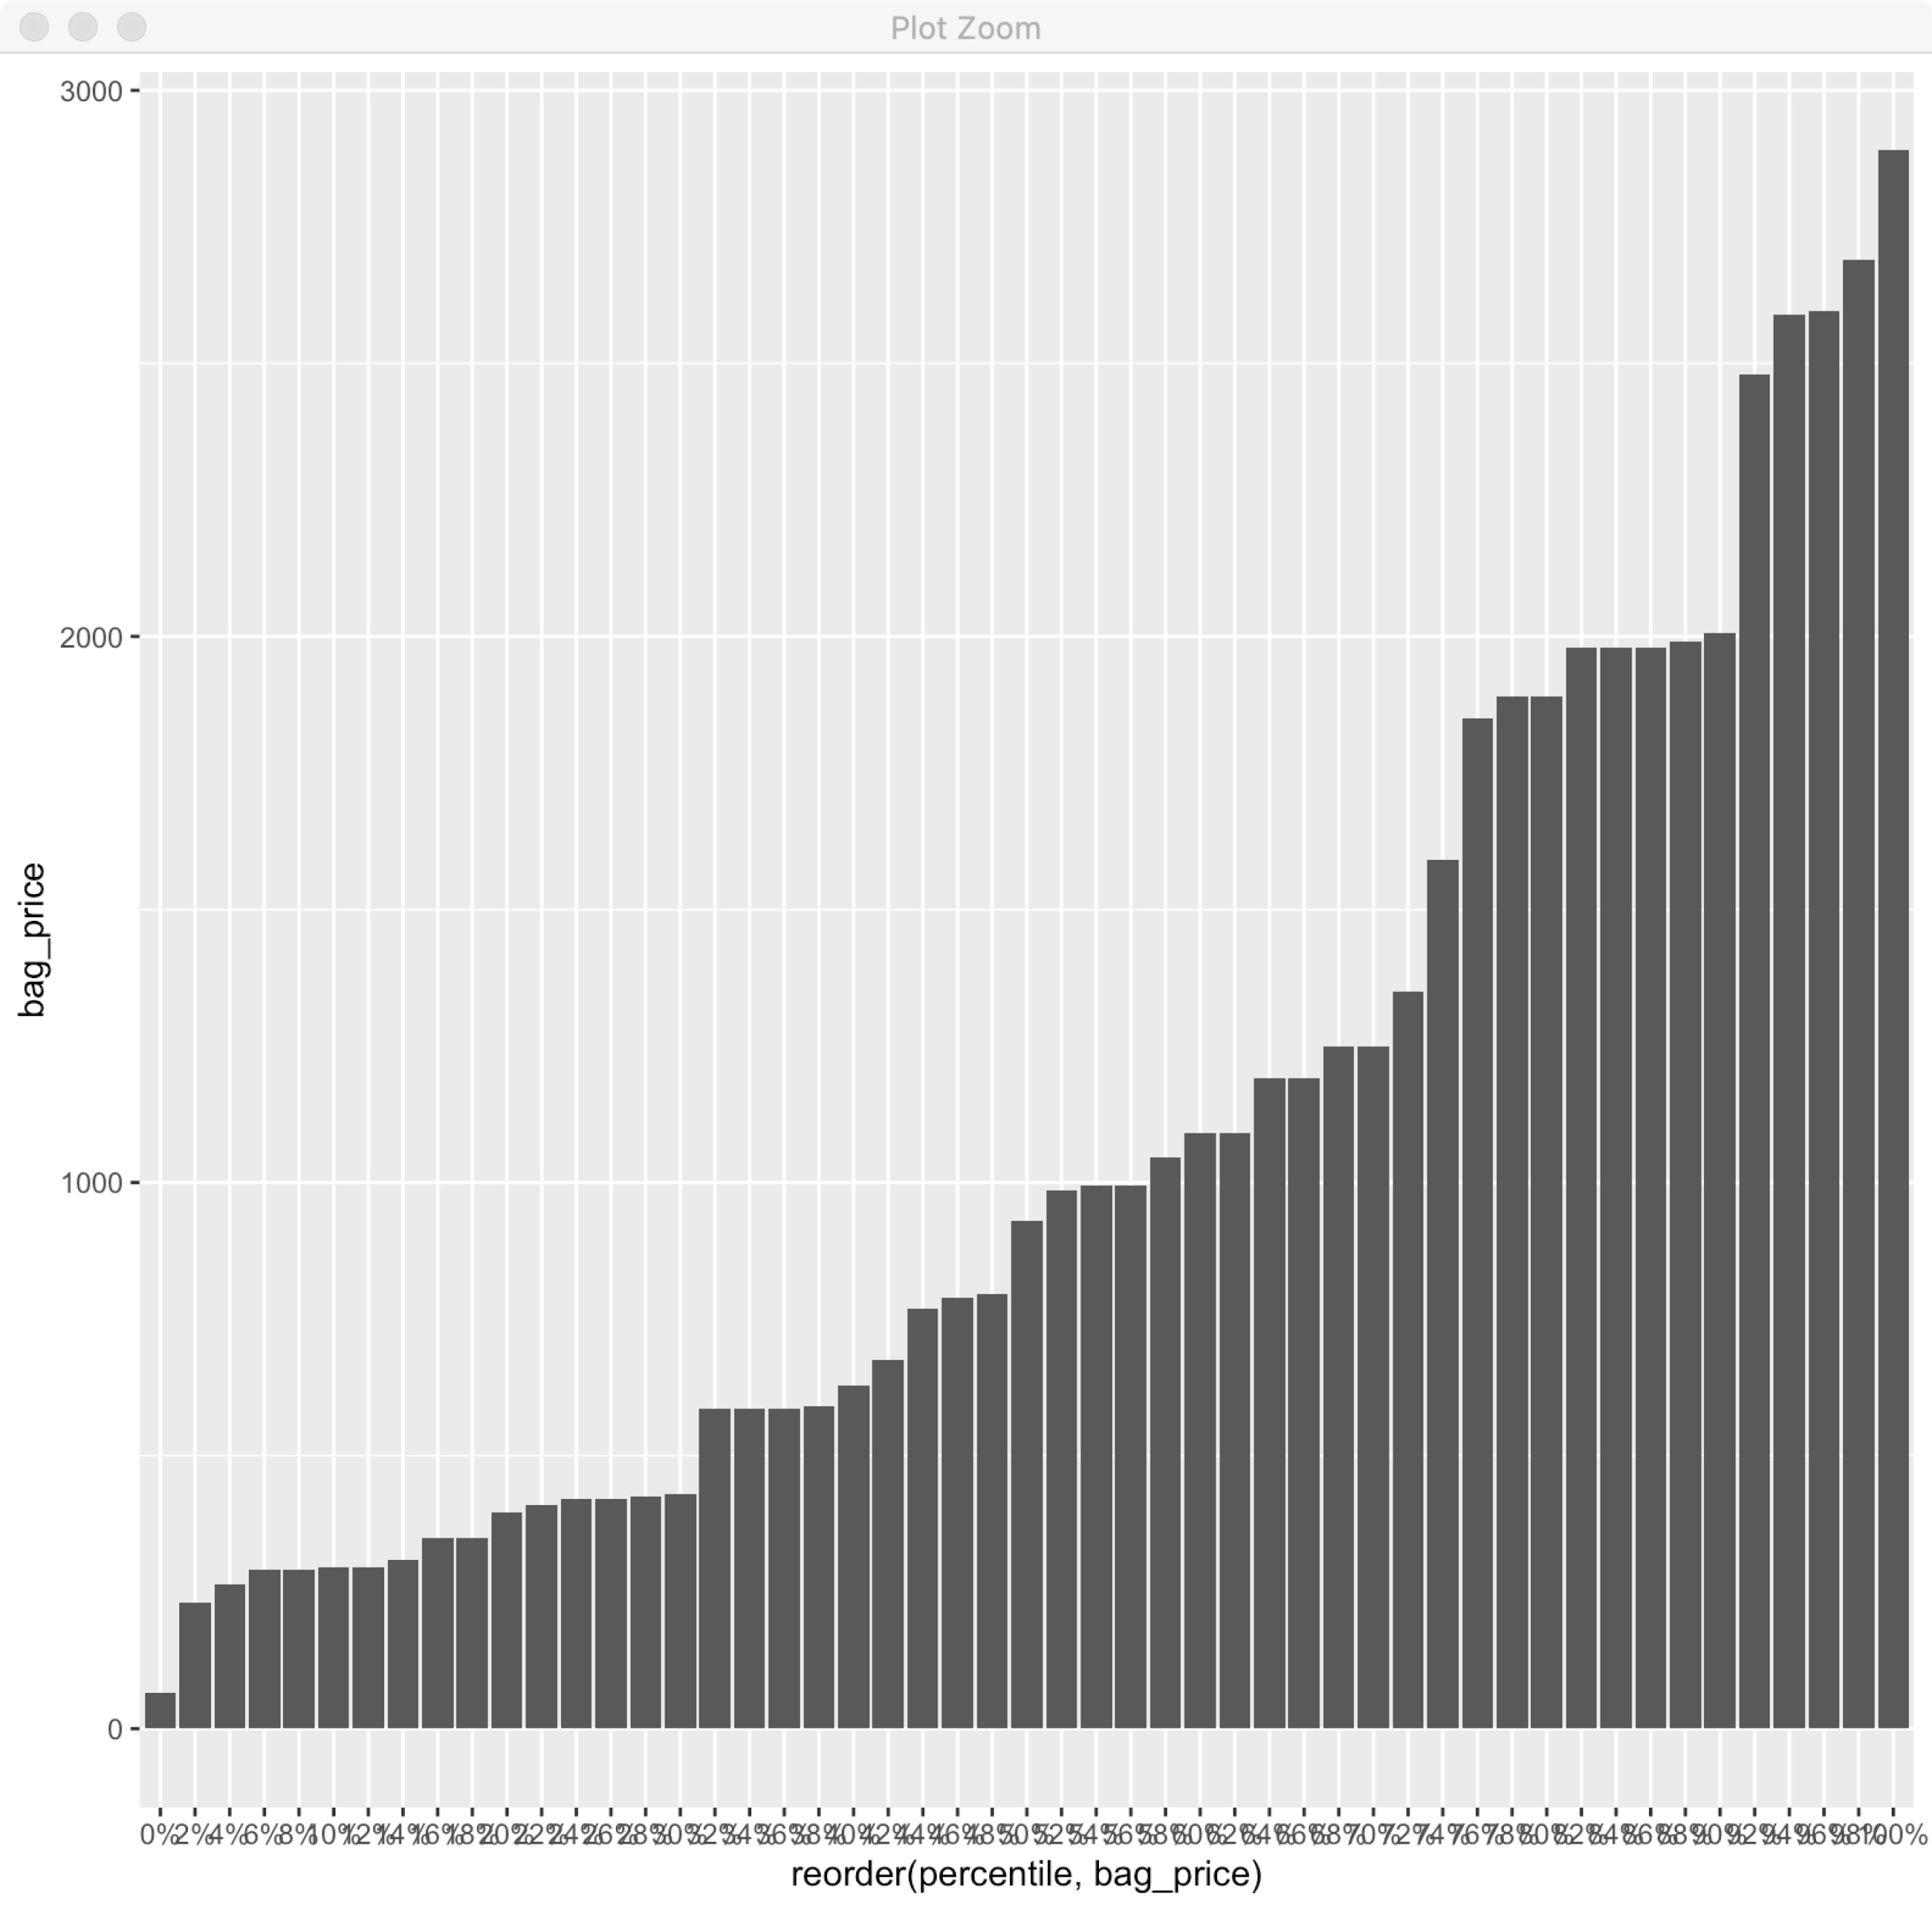
Exploratory Analysis
Key Insight 1
It is positively skewed since the mean price is a bit higher than the median. There are a few “high price” outlier(bags) in the list.

Slide 9
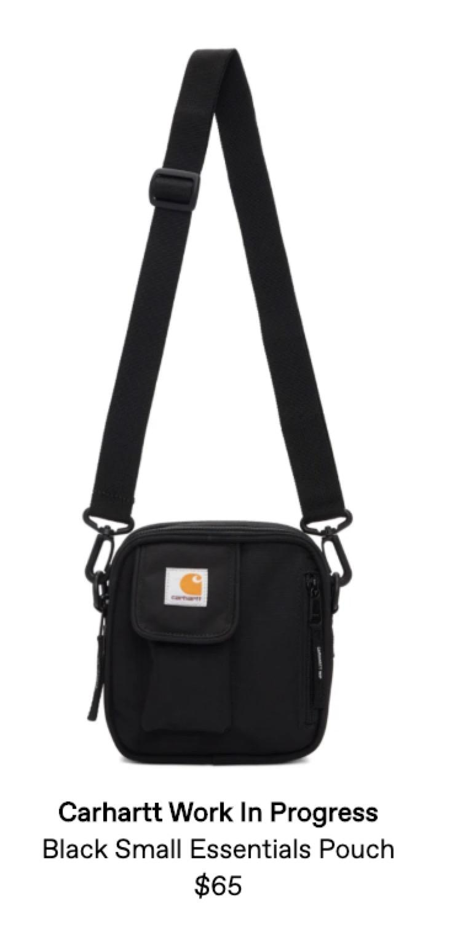
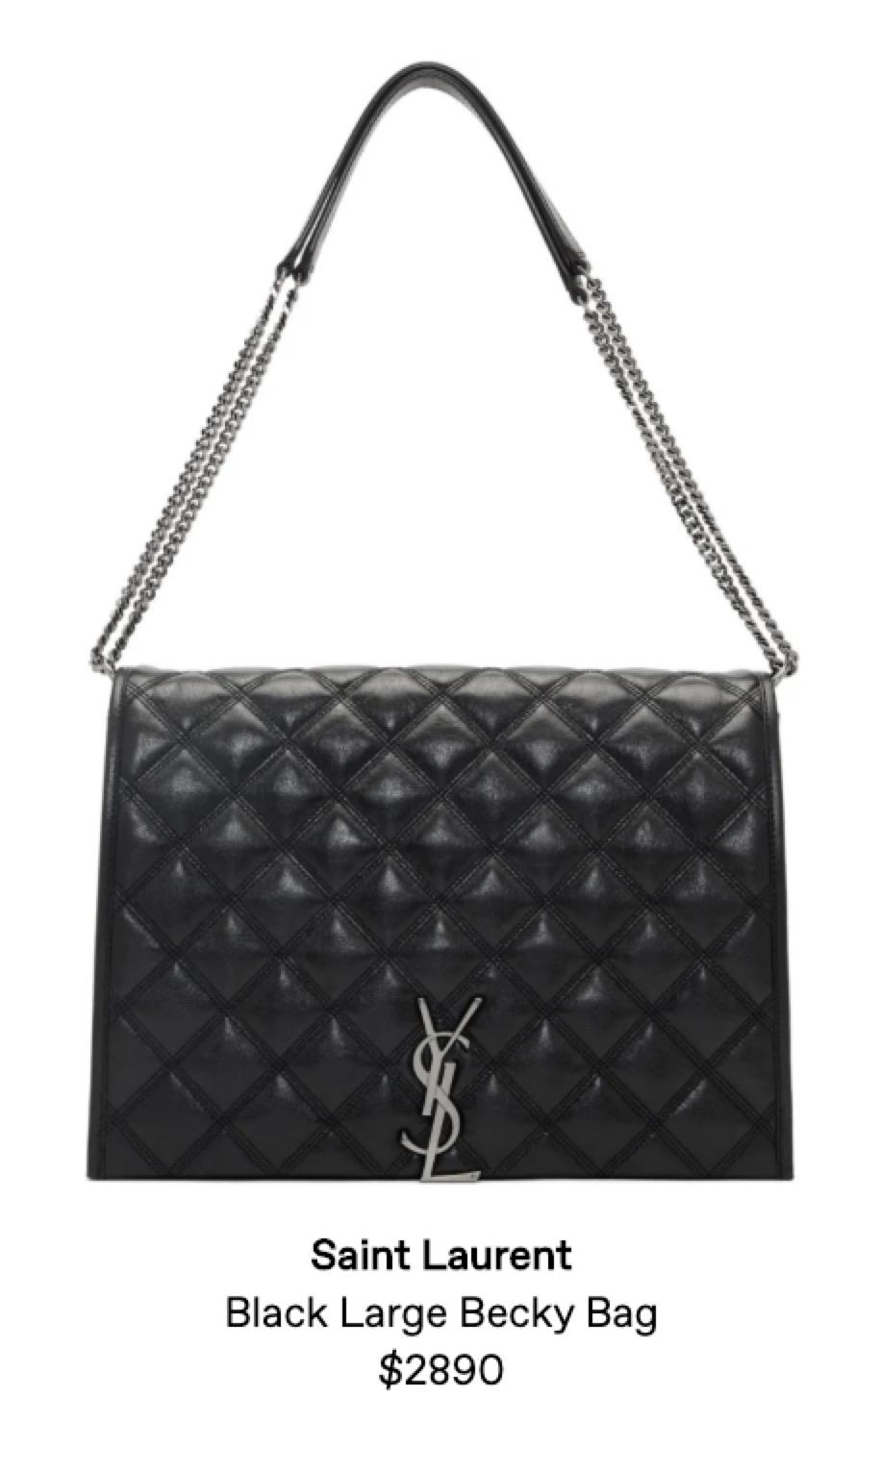
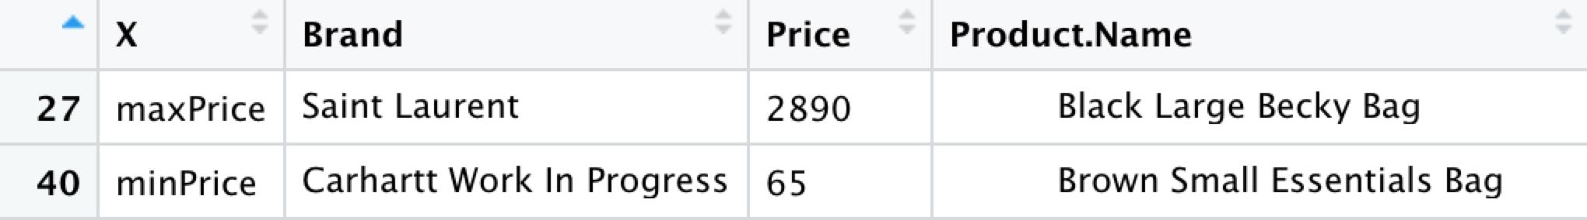
Exploratory Analysis
Key Insight 2
It shows the most expensive and the cheapest bags in top 10 pages by relevance.

Slide 10
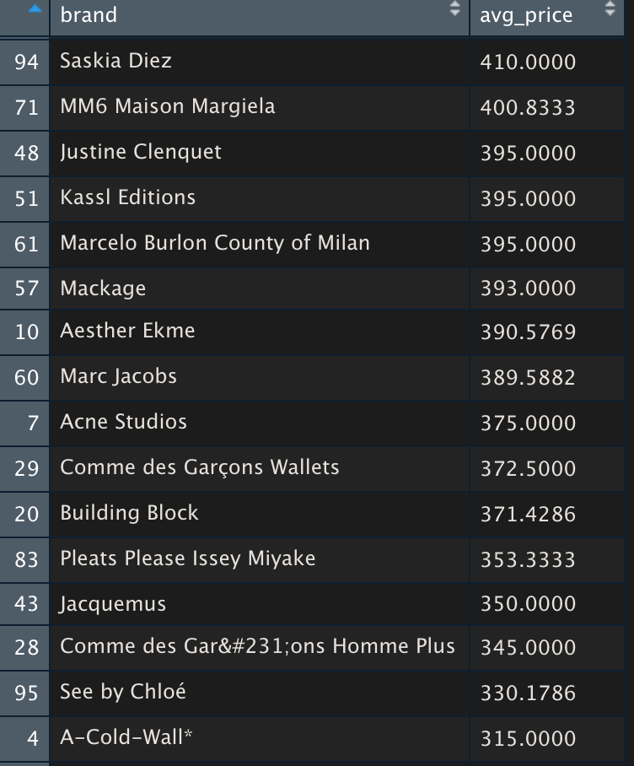
Exploratory Analysis
Key Insight 3
These brand shown in the dataframe are the close competitors with Parisa Wang (same price level).

Slide 11
Statistical Analysis
statistical approach and result
The statistical approach is to analyze the price distribution of bags in top 10 pages and then import and visualize via RStudio. Using percentile, min/max and aggregate function gets the 3 key insights.

Slide 12
Recommendations
takeaways to the stakeholders.
Have an idea on the competitive environment and their price distribution.
Determining the closest competitor according to their price level.

Slide 13
Recommendations
recommendations to the stakeholders
Compared with Parisa Wang, Acne Studios is the closest competitor whose average price is $375. It’s better to dig into its marketing practices such as advertising campaigns, pricing strategy and upsell existing consumers.

Slide 14
Recommendations
What can be done in the future?
It would help Parisa Wang make the further decision. Also setting the better marketing goal after analyzing competitor’s situation could increase its profit and occupy the market share.

Slide 15

Thank you!

Slide 16
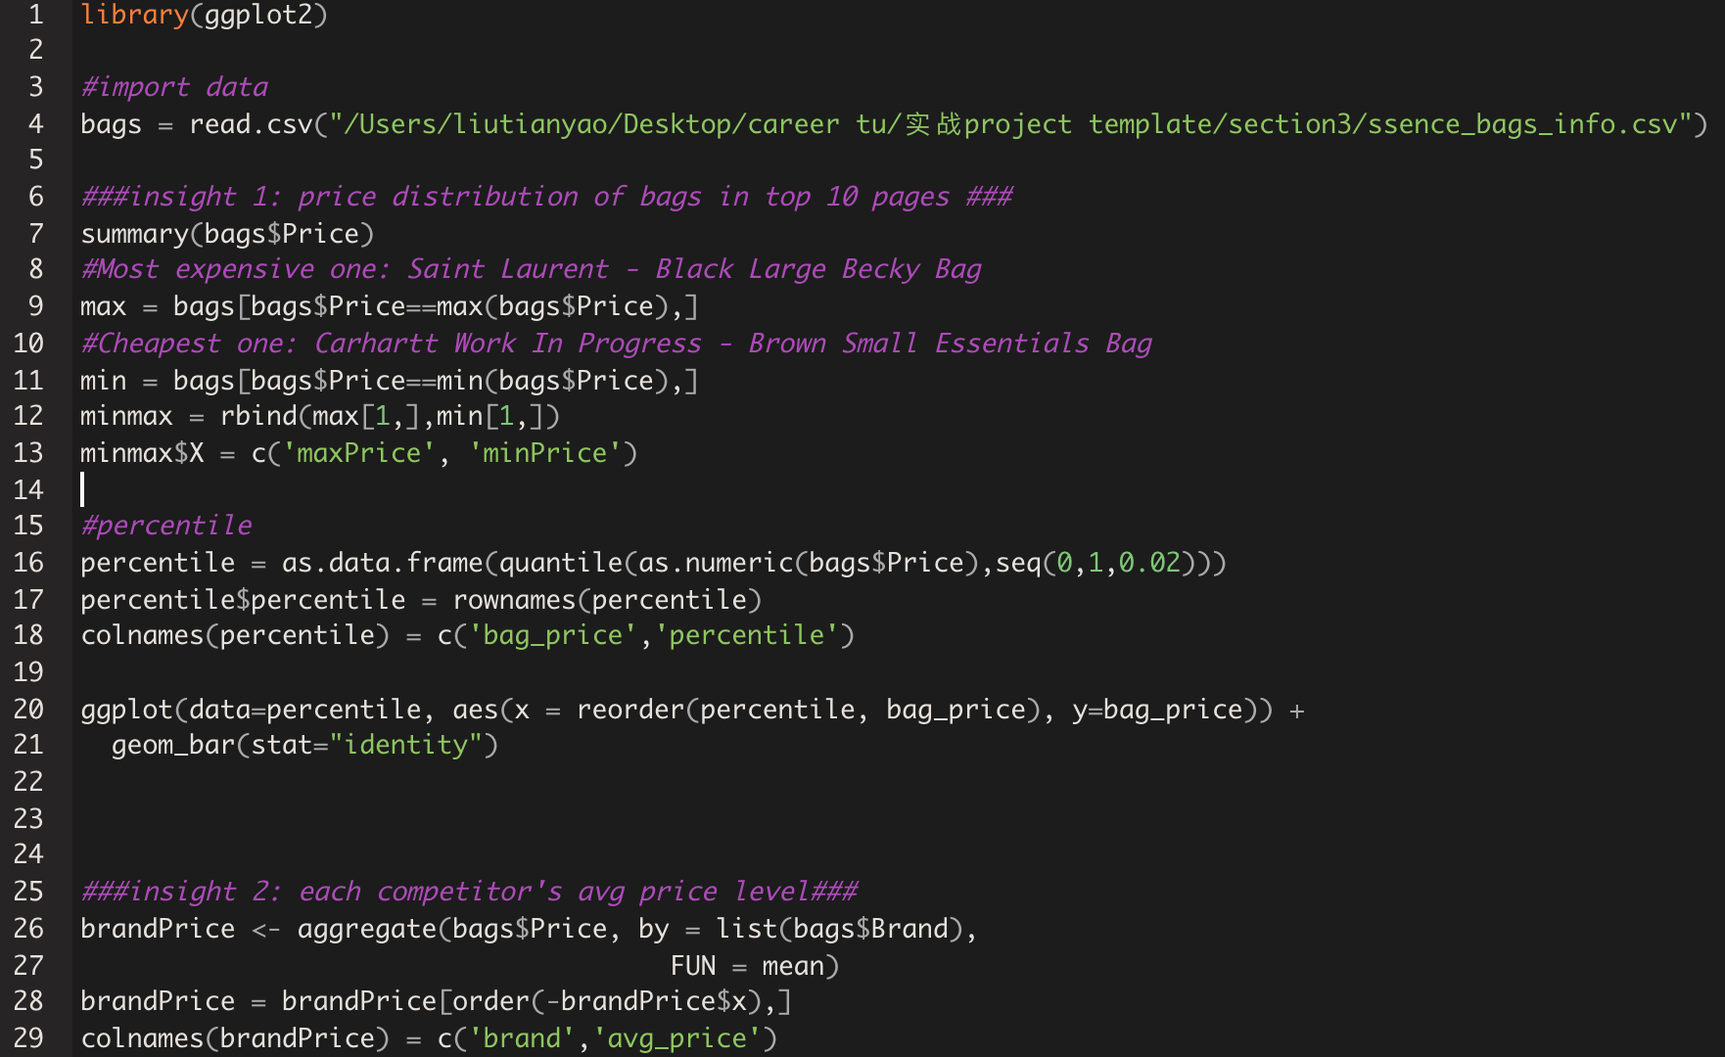
Appendix - R code

